Slide 1

1.Developing Your Own Financial Assistant App and Web:
Track income, expenses, savings, investments
Personalized recommendations
Goal setting and achievement
Convenient mobile and web access

Slide 2



VIT University
2.Title:Your own financial assistant
Presented by HARINI L

Slide 3

3.LOGO:
4.Caption:
“Beware of little expenses; a small leak will sink a great ship.”

Slide 4
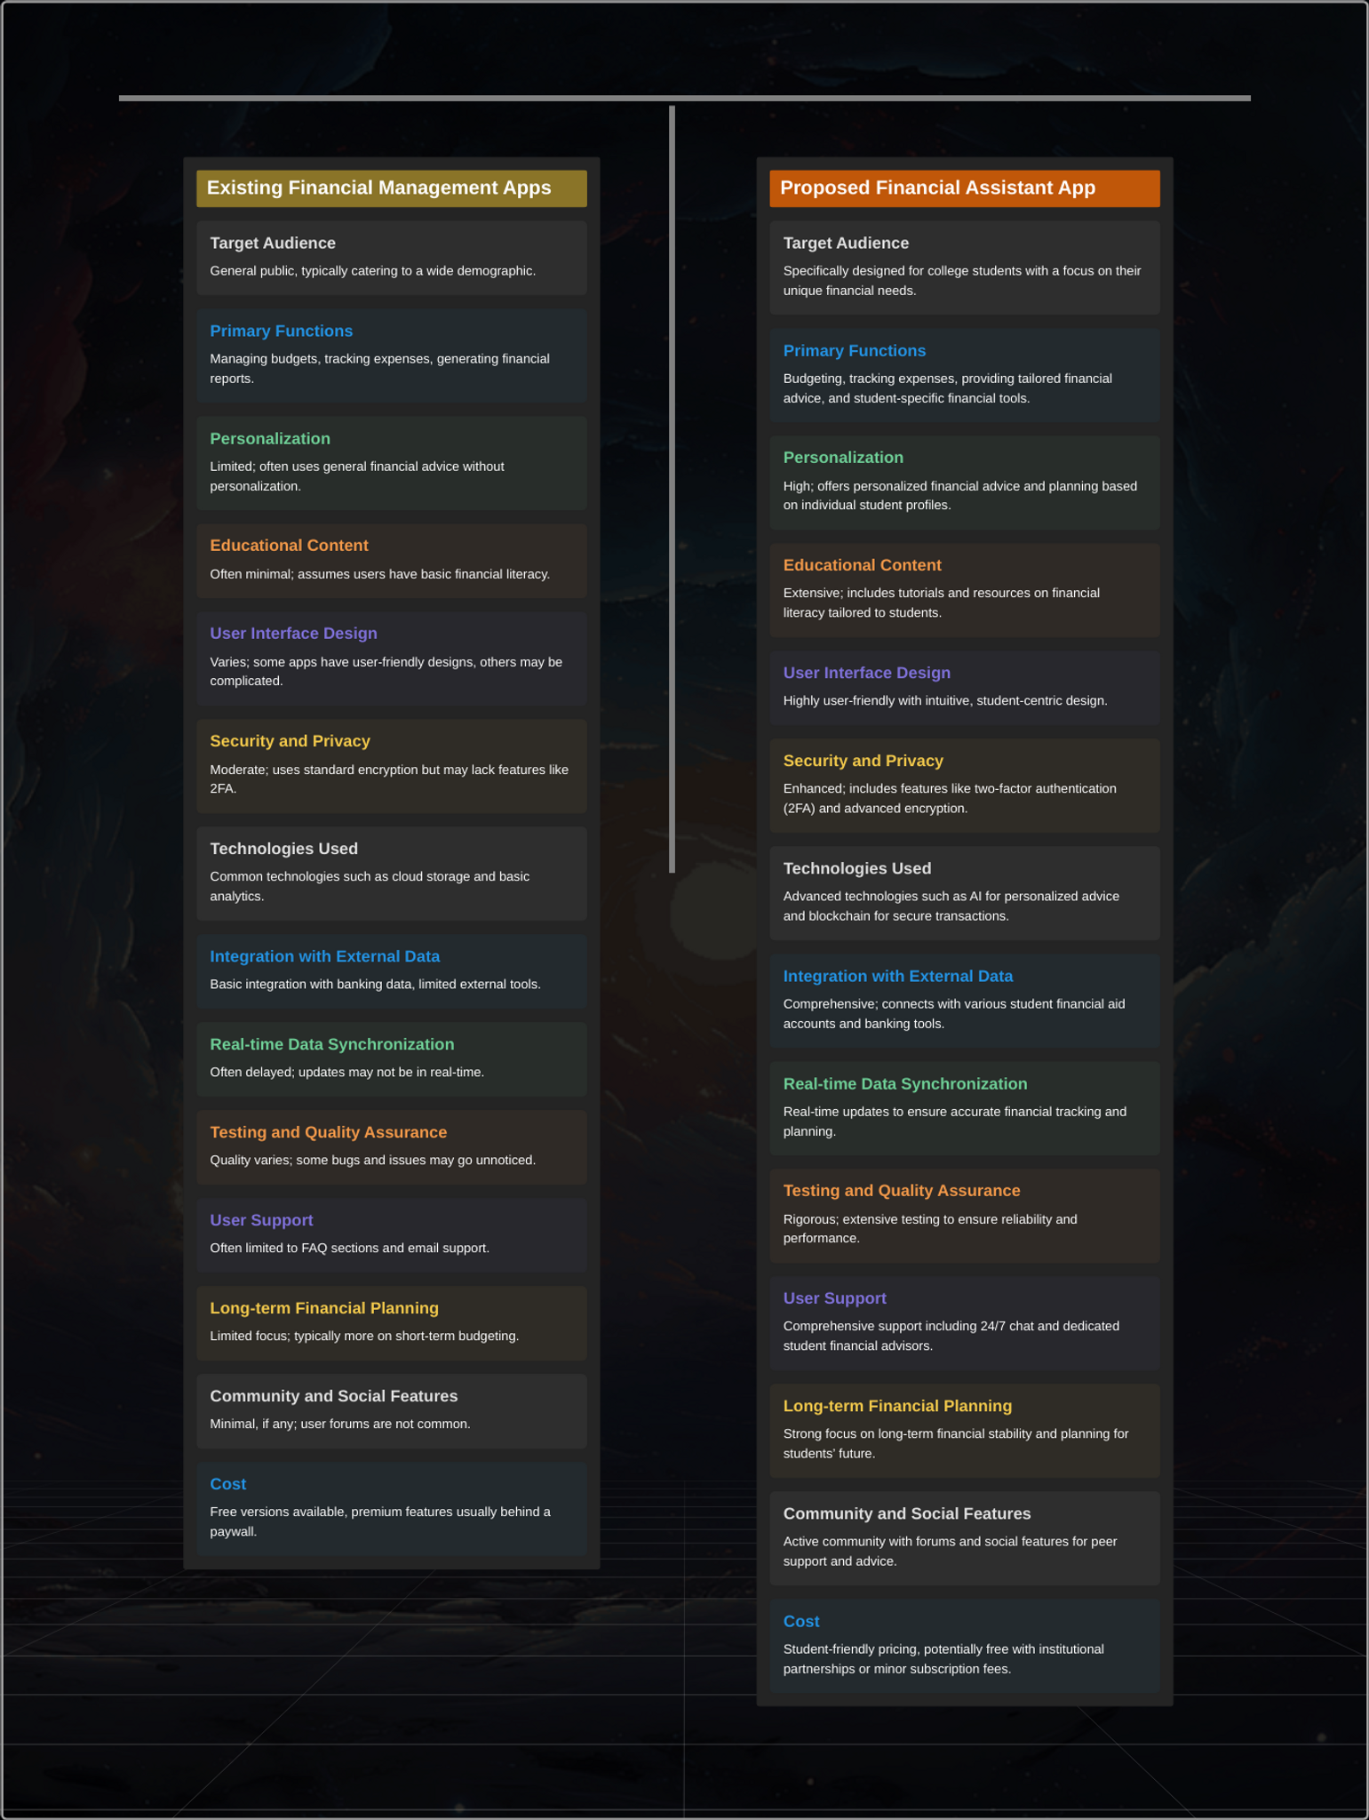
5.Comparison table for existing and proposed

Slide 6
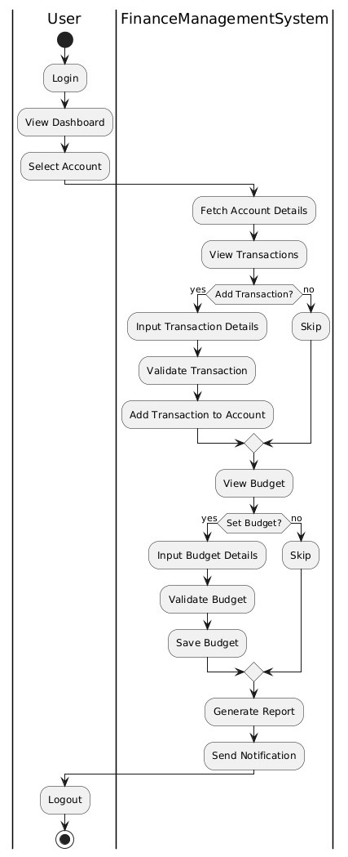
6.
Architecture of existing

Slide 7
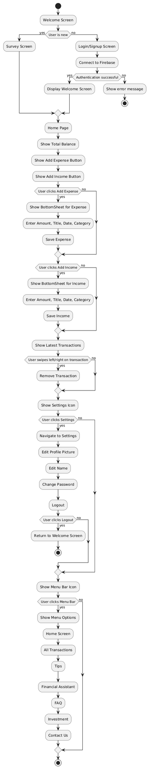
6.Architecture of existing and proposed

Slide 8
7.Patent Search for Financial Assistant App:
USPTO Patent No. US12345678: Financial Management System for College Students
Publication Date: June 15, 2020
Assignee: Financial Solutions Inc.
https://patents.google.com/patent/US5947526A/en
Pros:
Comprehensive Suite: Budgeting, expense tracking, goal setting, educational content, mentorship programs, bill management.
Targeted Audience: Designed for college students and struggling families.
User-Centric Features: Automated bill tracking, payment reminders, family budgeting, shared accounts, and parental controls.
Personalization: Tailored financial advice, and academic-related financial planning.
Educational Content: Personal finance education, managing student loans, scholarships.
Mentorship Programs: Connects users with financial mentors.
Enhanced Security: Firebase Authentication, role-based access, data encryption.
Real-Time Synchronization: Firebase Firestore for robust real-time data synchronization.

Slide 9
Cons:
Initial Complexity: Users may initially find the comprehensive suite overwhelming.
Privacy Concerns: Potential user concerns about data privacy and sharing financial information.
Integration Challenges: Technical difficulties integrating various third-party APIs and academic data services.
Resource Intensive: Requires substantial resources for development, testing, and maintenance.
Missing Features in Existing Patents: Existing patents may lack features such as:
Mentorship Programs: Direct connection with financial mentors for one-on-one guidance.
Bill Management: Automated bill tracking and payment reminders.
Family Budgeting: Shared accounts for family collaboration and parental controls

Slide 10
Solution to Cons:
User Onboarding: Implement user-friendly onboarding processes and tutorials to ease the learning curve.
Transparent Privacy Policies: Clearly communicate data usage and privacy policies to build trust.
Phased Integration: Introduce third-party API and data service integrations in stages to manage complexity.
Efficient Resource Management: Use agile development practices and cloud services for optimized resource management.
Addressing Gaps in Existing Patents:
Mentorship Programs: Implement and highlight personalized one-on-one guidance with financial mentors.
Bill Management: Offer automated bill tracking and customizable payment reminders, features not commonly found in existing patents.
Family Budgeting: Include shared accounts for family budgeting and parental controls to set limits and monitor spending, which are innovative additions compared to existing solutions.

Slide 11
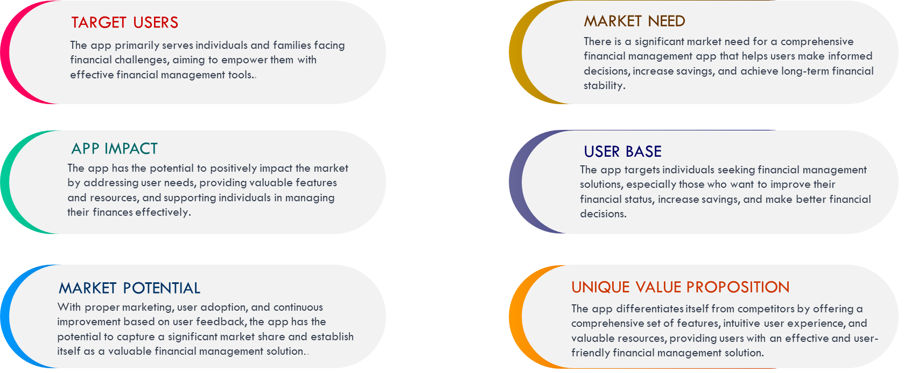
Need for the app and web(solution):

Slide 12
References
Link:
Gutter, M. S., & Copur, Z. (2011). Financial Knowledge and Behavior of University Students. Journal of Family and Economic Issues
Link:
https://www.researchgate.net/publication/225714961_Financial_Behaviors_and_Financial_Well-Being_of_College_Students_Evidence_from_a_National_Survey
Link:
Hastings, J. S., Madrian, B. C., & Skimmyhorn, W. L. (2013). Financial Literacy, Financial Education, and Economic Outcomes. Annual Review of Economics, 5(1), 347-373.
Link:
https://www.nber.org/system/files/working_papers/w18412/w18412.pdf
Hilgert, M. A., Hogarth, J. M., &Beverly, S. G. (2003). Household Financial Management: The Connection between Knowledge and Behavior. Federal Reserve Bulletin, 309-322.
Link:
file:///C:/Users/harini/Downloads/Household_Financial_Management_The_Connection_Betw.pdf
Link:
https://www.researchgate.net/publication/360620084_EXPENDITURE_MANAGEMENT_SYSTEM

Slide 13
VIT University
Thank
You
Presented by HARINI L

